Slide 1


NextHikes Project 4:
Enhancing Pricing Strategy Through Feature Extraction
Predicting Mobile Phone Prices in a Competitive Market.
BY- Avantika Verma

Slide 2


Project Objective: Data-Driven Pricing
Goal
Develop a predictive model for mobile phone prices.
Benefit
Optimize pricing to maximize profitability and market share.
Methodology
Use feature extraction and machine learning Algorithm
Key Question
Which features really drive mobile phone prices?

Slide 3

Data Collection and Preparation
Gather Data
Key Variables
From various sources. Specifications, reviews, pricing history
Technical specifications, brand, OS, customer ratings.
Clean & Preprocess
Handle missing values, outliers, and inconsistent formats.

Slide 4

Data Analysis
Data Overview
Total Entries: 541
Total Features: 12
Data Types:
◦ Numerical Features: 6
◦ Categorical Features: 5
Target Variable: Mobile Sales Price
• Key Objective:
Predict mobile prices based on Their Model , Colour , RAM, Battery size , Processor , Camera etc.
Data Exploration
Missing Value /NAN Value Analysis -No columns have missing/nan values.
Unnamed: 0→ Dropped due to the unused column

Slide 5







Feature Extraction Techniques
Correlation Analysis
Identify features strongly correlated with price.
Principal Component Analysis (PCA)
Reduce dimensionality while retaining key information.
Feature Importance from Machine Learning

Slide 6
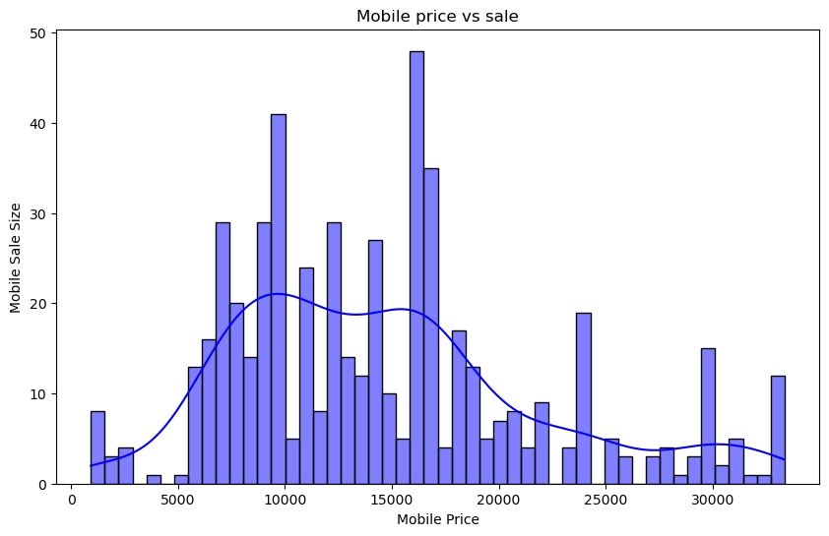

Distribution Of Sales Price
Distribution Shape:
The distribution appears right-skewed (positively skewed).
This suggests that while most Mobile have relatively higher prices.
Peaks & Mode:
The distribution has multiple peaks, indicating that sale prices are not normally distributed.
The most frequent sale price range appears to be around 15000-16000, where the highest bar is observed.

Slide 7
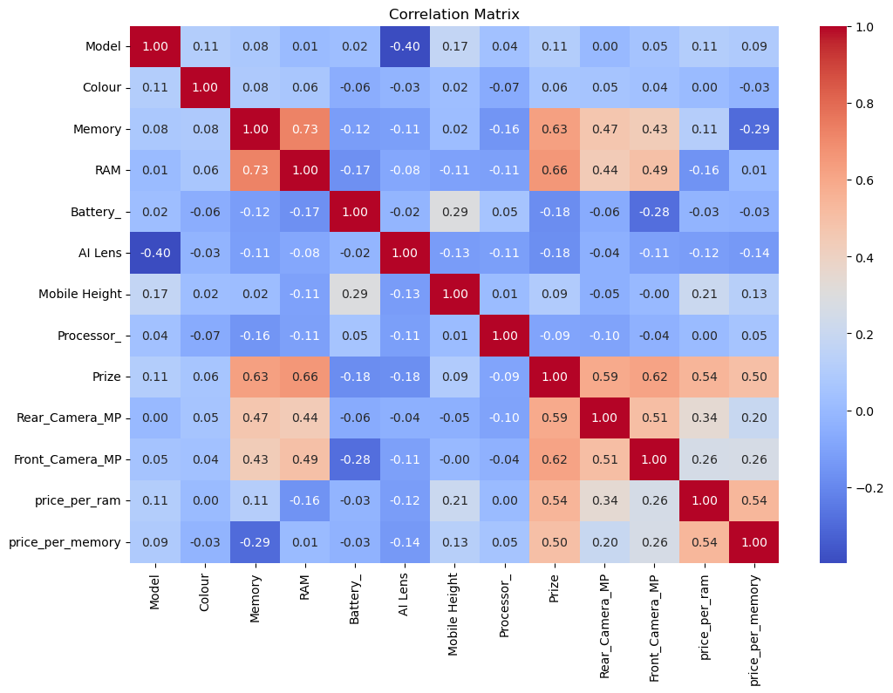

Strong correlations with sale price
Key Insight Of Heat Map-
RAM (≈ 0.73):
Higher RAM is associated with higher mobile prices.
Memory (≈ 0.63):
More storage leads to a higher price.
Processor (≈ 0.50):
The processor type has a moderate impact on price.
Rear Camera MP & Front Camera MP (≈ 0.20 - 0.26):
Slightly influences price but not as strongly as RAM and storage.
RAM & Memory (≈ 0.73):
Higher RAM is often found in phones with higher storage.

Slide 8
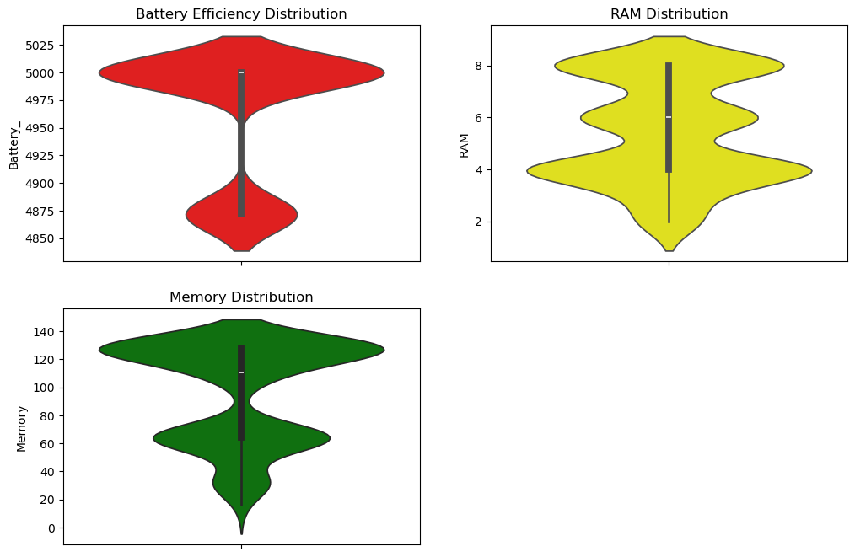
Violin Plots
Key Insights from Violin Plots-
📌 1. Battery Efficiency Distribution (Red) –
Bimodal distribution suggests two common battery efficiency levels.
📌 2. Battery Outliers –
A few phones have significantly lower battery efficiency, affecting overall performance.
📌 3. RAM Distribution (Yellow) –
Multi-modal shape indicates distinct RAM groups (e.g., 4GB, 6GB, 8GB).
📌 4. RAM Trends –
Wider sections highlight popular RAM configurations, while fewer phones have low RAM.
📌 5. Memory Distribution (Green) –
Two peaks suggest clear segmentation between low-end & high-end storage models.
📌 6. Mid-Range Storage Gap –
Fewer phones exist in the mid-range memory segment, creating a potential market gap.
📌 7. Market Implication –
Companies should focus on optimizing battery efficiency, RAM, and storage offerings based on these distribution trends.

Slide 9
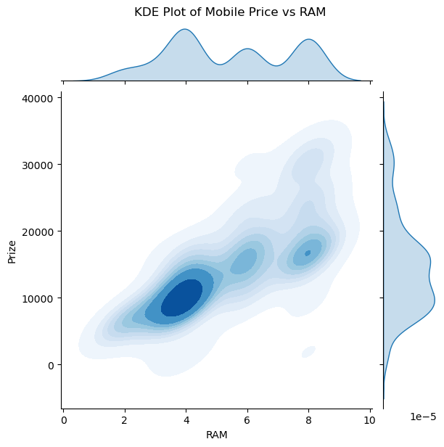

KDE Plot (RAM vs Mobile Price))
Key Insights from KDE Plot (RAM vs Mobile Price)-
📌 1. Strong Positive Correlation – Higher RAM generally leads to higher mobile prices. 📌 2. Most Common Segment – Majority of phones have 2GB-4GB RAM and are priced between ₹5,000 - ₹15,000. 📌 3. Premium Phones are Less Frequent – Devices with 6GB+ RAM exist but form a smaller market share. 📌 4. Price Spreads Widely for Budget Phones – Entry-level devices (0GB-2GB RAM) have varied pricing due to brand & other features. 📌 5. High-End Models Have Less Density – 8GB+ RAM flagship models are priced significantly higher but are rarer in the dataset. 📌 6. Mid-Range Market Opportunity – Since most phones fall in the 2GB-6GB RAM range, this segment has high sales potential. 📌 7. Competitive Pricing Trends – The KDE plot suggests overlapping price ranges across RAM segments, indicating a competitive market.

Slide 10
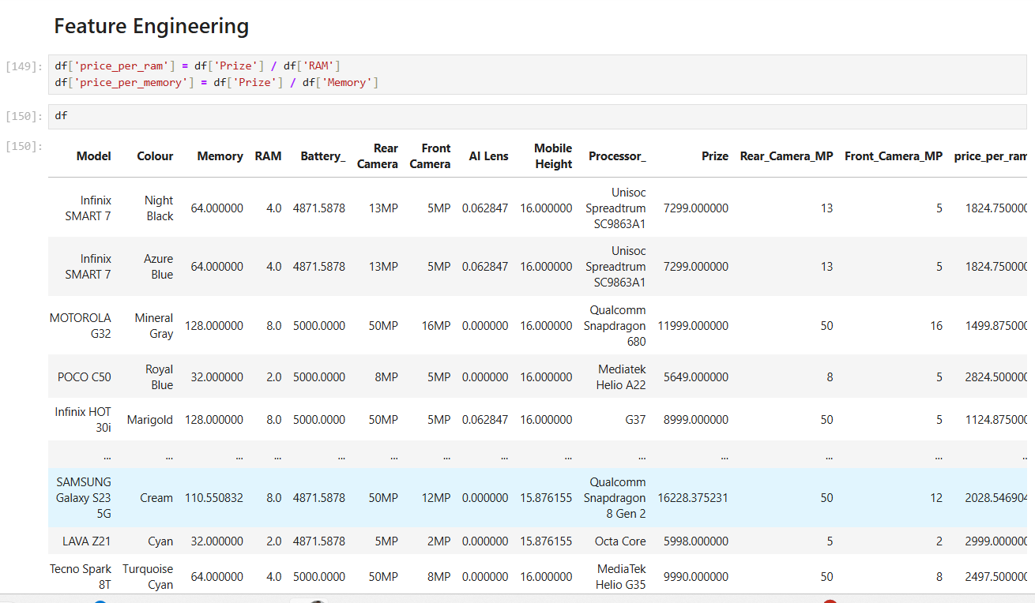

Feature Engineering

Slide 11



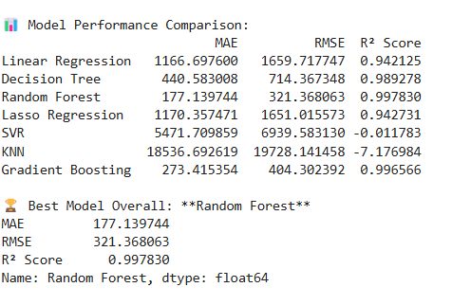

Model Building and Evaluation
2
Split Data
Into training and testing sets
Select Models
3
Evaluate Performance
Linear Regression,
Decision Tree,
Random Forest Regressor,
SVR,
KNN,
LASSO Regression,
Gradient Boosting Regressor.
1
R-squared, MAE, RMSE.

Slide 12
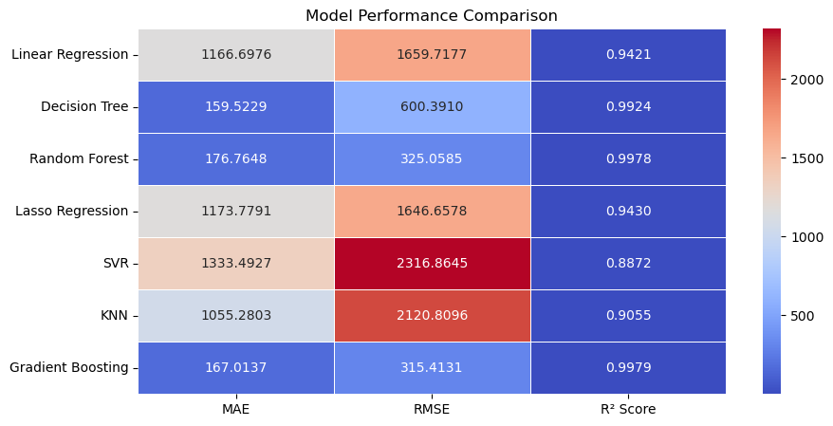


Model Comparison
📌 Gradient Boosting & Random Forest Perform Best –
Lowest MAE, RMSE, and highest R² score (~0.998). 📌 Decision Tree Also Performs Well –
Competitive accuracy with low errors. 📌 Linear & Lasso Regression Show Moderate Performance –
Higher error values but decent R² (~0.94). 📌 SVR & KNN Perform Poorly –
Highest RMSE, MAE, and lowest R² (~0.88 - 0.90). 📌 Gradient Boosting Has the Lowest Error –
MAE = 167, RMSE = 315, ensuring high precision. 📌 Random Forest is a Strong Contender –
Slightly higher error than Gradient Boosting but still highly accurate. 📌 Recommendation –
Use Gradient Boosting or Random Forest for mobile price prediction models.

Slide 13
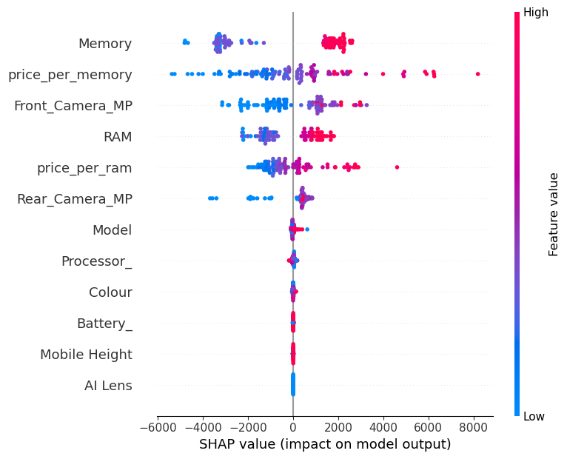



SHAP Insights: Understanding Model Predictions
📌 Key Features Impacting Price:
Memory, Price per Memory, Front Camera MP, RAM, Price per RAM, Rear Camera MP. 📌 Most Influential Factor:
Memory has the highest impact on price prediction. 📌 SHAP Value Meaning:
Positive values increase price, negative values decrease price. 📌 Color Interpretation:
🔴 Red = High feature values,
🔵 Blue = Low feature values. 📌 RAM & Camera Impact:
More RAM & higher MP cameras increase price. 📌 Less Influential Features:
Battery, AI Lens, Mobile Height, Colour, Processor. 📌 Insights for Optimization:
Focus on memory & RAM for better price predictions.

Slide 14
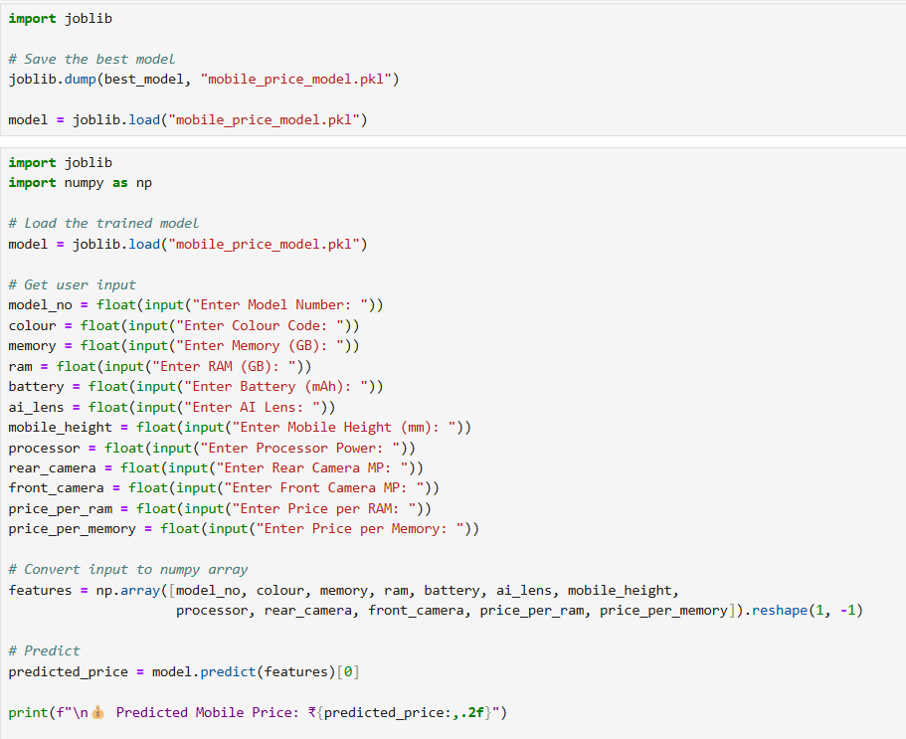
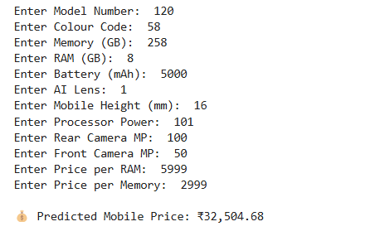

Model Deployment

Slide 15
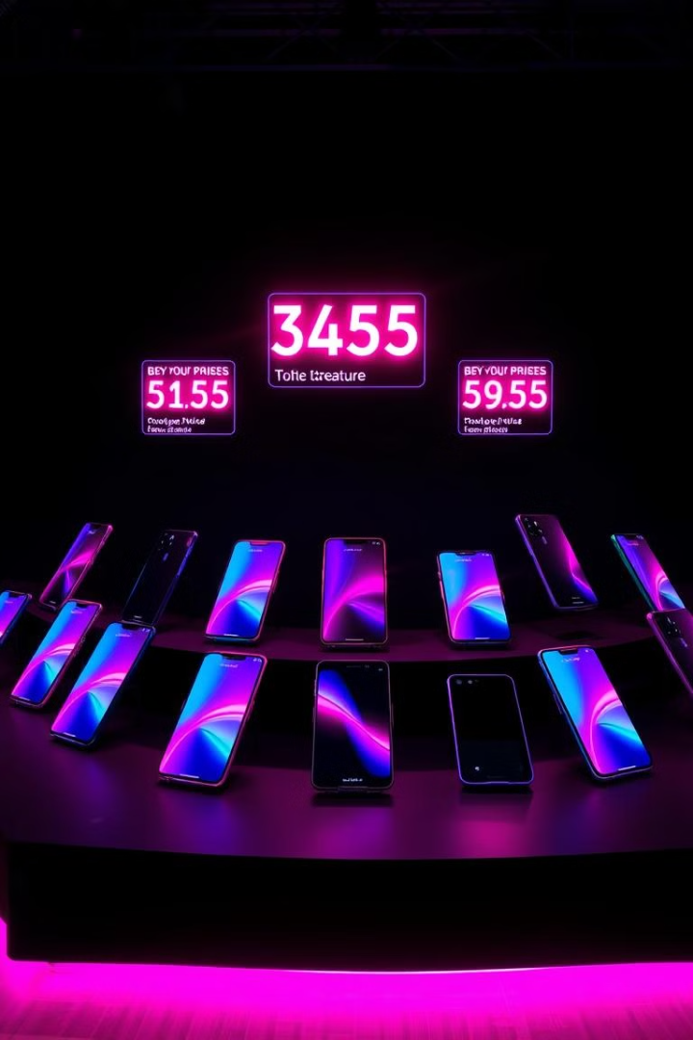


Recommendation for Competitive Advantage
📌 Prioritize RAM & Storage – Key price drivers, offer multiple configurations & bundle pricing. 📌 Camera Quality Matters – Enhance AI-driven features & market megapixel + software optimizations. 📌 High-Performance Processors – Justify premium pricing by partnering with top chip manufacturers. 📌 Battery & AI Lens – Minimal impact on price, focus on fast charging & use AI Lens as a value-add. 📌 Feature-Based Pricing Tiers – Define clear segments: Budget, Mid-Range, Flagship models. 📌 AI-Powered Pricing Strategy – Optimize pricing dynamically based on demand & competition. 📌 Final Takeaway – Invest in RAM, Storage, Camera & Processors to maximize revenue & brand value.

